Slide 1
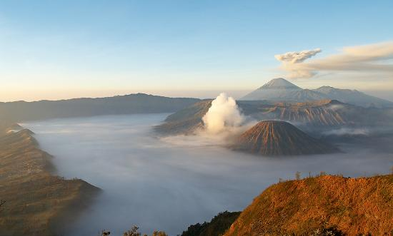


MALAYSIA
2nd Divisional Meeting of UNGEGN,
Asia South East
Bandung, Indonesia
2nd April 2014
Malaysian National Committee on
Geographical Names

Slide 2
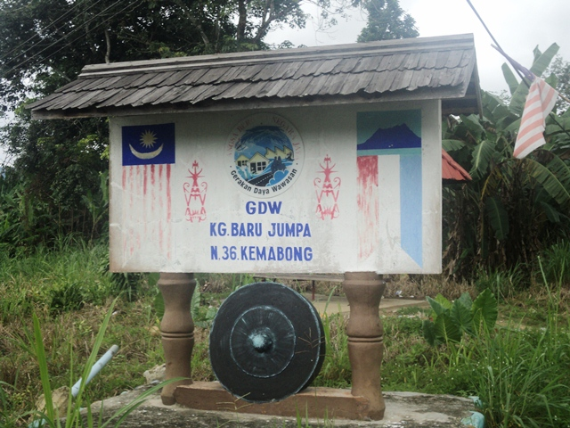

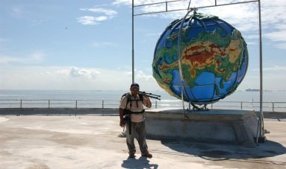
OUTLINE
Introduction
Background
Activities
Conclusion

Slide 3
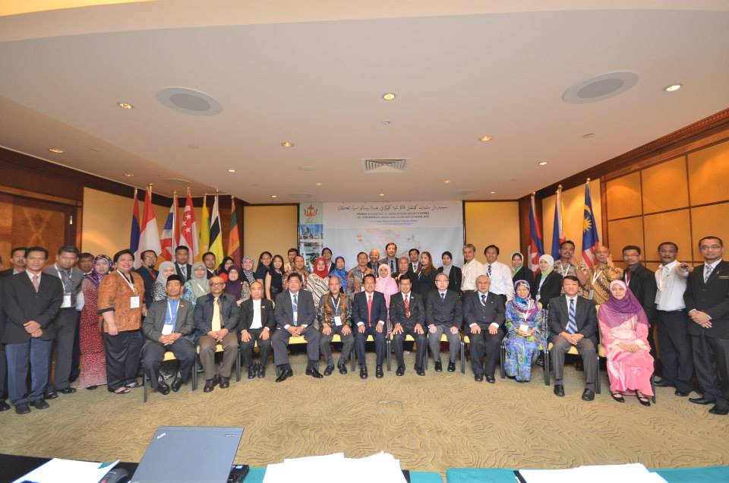
INTRODUCTION
This report covers the period from May 2013 to March 2014 since the last meeting which was held in Brunei Darussalam.

Slide 4
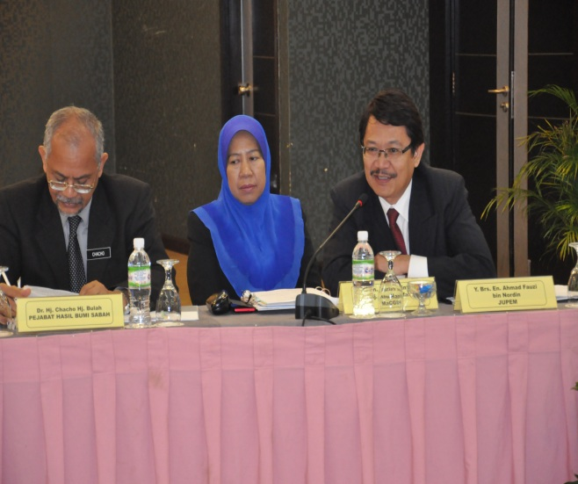
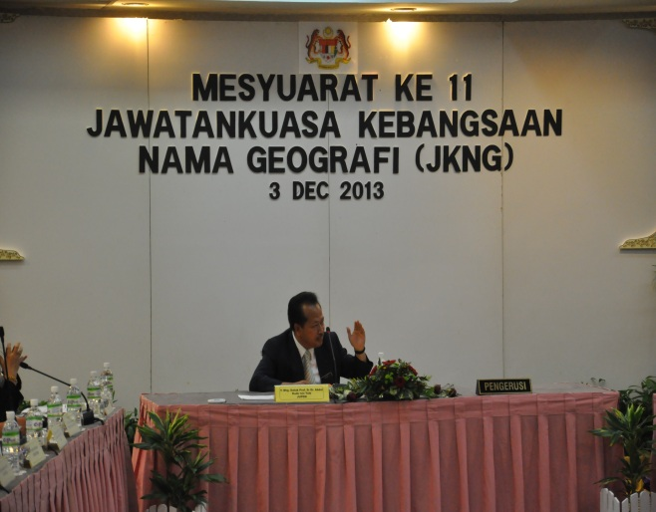
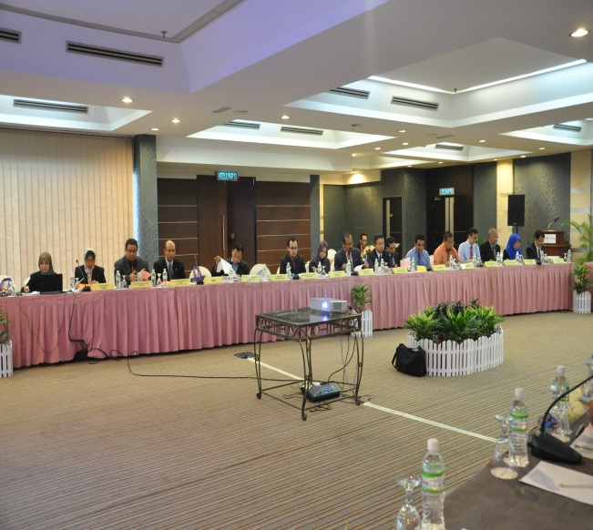
BACKGROUND
The Malaysian National Committee on Geographical Names (MNCGN) was established on 11 September 2002 by the Malaysian Cabinet.
Director General of the Department of Survey and Mapping Malaysia, Chairs.
Members consisting of representatives from the
federal and state agencies.
11th Meeting was held in Penang on 3rd December 2013.

Slide 5
Organizational Structure of
Malaysian National Committee on Geographical Names
MALAYSIAN NATIONAL COMMITTEE ON GEOGRAPHICAL NAMES
(MNCGN)
STATE COMMITTEE ON GEOGRAPHICAL NAMES (SCGN)
NATIONAL TECHNICAL COMMITTEE ON GEOGRAPHCAL NAMES
(NTCGN)
STATE TECHNICAL COMMITTEE ON GEOGRAPHICAL NAMES
(STCGN)
WORKING GROUP ON POLICY AND GEOGRAPHICAL NAMES UPDATING
WORKING GROUP ON
GEOGRAPHICAL NAMES DATABASE AND GAZETTEER
WORKING GROUP ON NAMES OF ISLAND AND GEOGRAPHICAL ENTITIES

Slide 6
The responsibilities of the committee include:
Developing a national guideline for nomenclature
matters;
Developing a National Geographical Names Database
and the National Gazetteer;
Promoting the use of official names; and
Coordinating Malaysian input into international
nomenclature activities, including liaison with the
United Nations Group of Experts on Geographical
Names, particularly the Regional Grouping.

Slide 7
Terms of reference include:
Establishing criteria to determine official geographic names;
Formulating guideline for the formation of National Geographical Names Database;
Coordinating the objectives, functions and output of activities;
Establishing the methodologies for the activities of the on-line geographical Names, National Gazetteer, National Standard Document and other activities; and
Collaborate with the National Mapping and Spatial Data Committee, TC2 SIRIM and other related committees.

Slide 8
ACTIVITIES
1. National Technical Committee on Geographical Names Meeting
14th Meeting on 31st January 2013 – Ipoh, Perak
15th Meeting on 3rd September 2013 – Kuching, Sarawak
Deputy Director General of Survey and Mapping Malaysia I, Chairs.
Activities and work progress of all the Working Groups and State Technical Committee were presented.

Slide 9
2. Geographical Names Database and
Production of Web Gazetteer
Working Group on Geographical Names Database and Gazetteer, chair by Malaysian Centre for Geospatial Data Infrastructure (MaCGDI).
The Malaysian Geographical Names Database (PDNG) consist of amongst others local names, location, historical background, Arabic character, audio file and gazette notification that have authoritative records available for government and public use.
MyGeoName application can be accessed at http://standard.mygeoportal.gov.my/geoname/

Slide 10
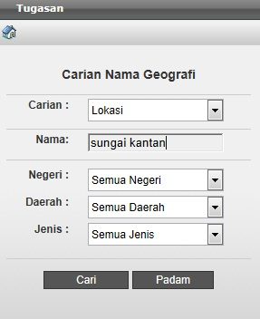
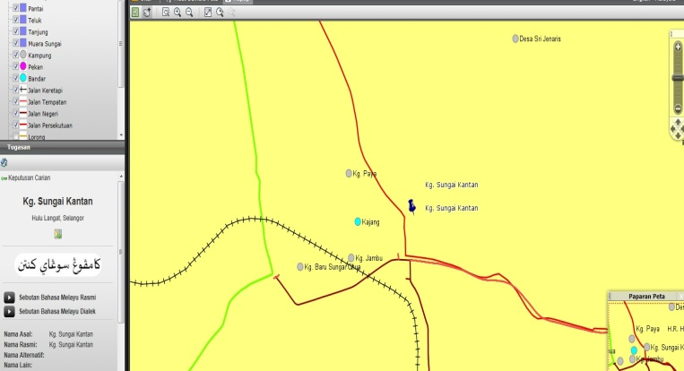
MyGeoName Application modules are as follows:
Searching Module
- enables users to search the geographical names according to states, districts or types.

Slide 11
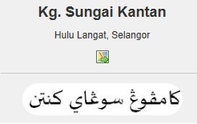
MyGeoName Application modules are as follows:
ii. Arabic (Jawi) Character Module
- few states in Malaysia have requested for the use of “Jawi” or Arabic signage for geographic names besides the Romanized system that are in used.
- the geographical names which have been translated to Jawi character will be validated by Institute of Language and Literature Malaysia (Dewan Bahasa dan Pustaka -DBP).

Slide 12
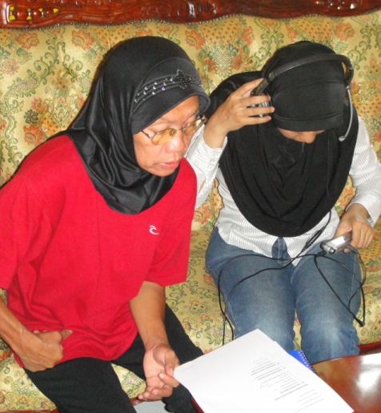
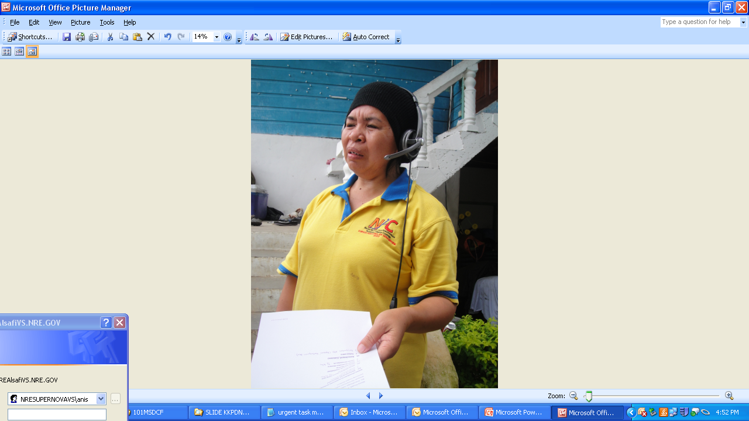
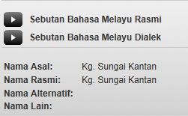
MyGeoName Application modules are as follows:
iii. Audio Module
- two (2) versions of “Audio File” had been developed to represent its different ways of pronunciation.
- first version represents pronunciation using standard language whilst the second version represents dialect pronunciation of the local community of the state.

Slide 13
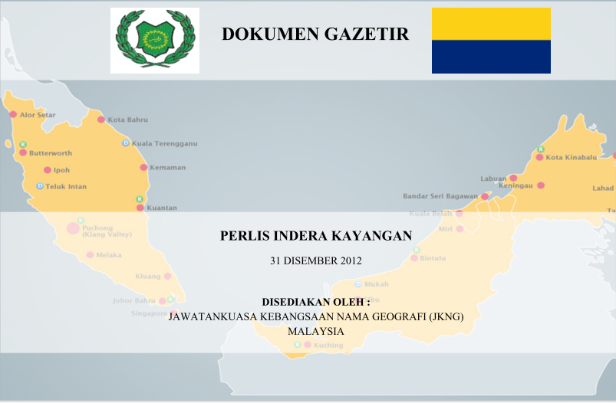
MyGeoName Application modules are as follows:
iv. Gazetter Document Publishing Module
- contains a list of geographical names, the type and location of each geographical name found in the state.
- the document will be published in stages depending on the progress of each state to complete their verfification of geographical names and names of the islands.

Slide 14
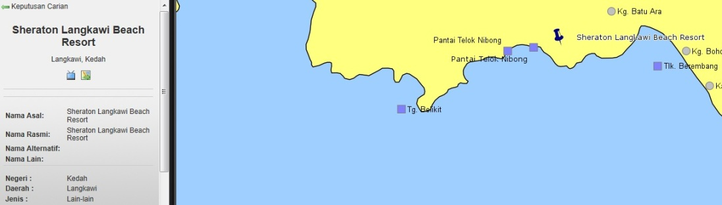
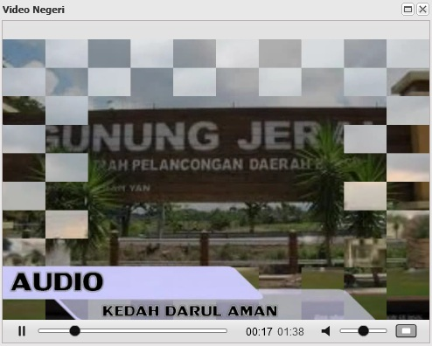
MyGeoName Application modules are as follows:
v. Virtual Reality Module
- for some points of interest, this module enables users to view the related places.

Slide 15
MyGeoName Application modules are as follows:
vi. Online Updating Module
- this module allows the updating processes of textual data and geospatial data to be fully automated.
- the ‘Google Map’ is also connected in this module to identify the location of geographical names.
- also generates report on updating of geographical names.

Slide 16
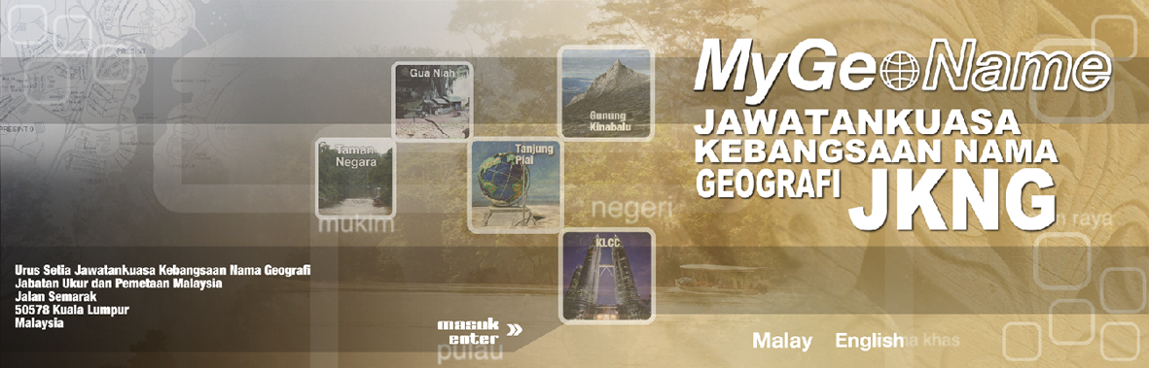
3. Website on Geographical Names in Malaysia
The Department of Survey and Mapping Malaysia has launched the MNCGN website called “MyGeoname” in July 2006.
Through this website all information related to geonaming activities can be accessed at http://www.jupem.gov.my/Geonames/splash.aspx by all the MNCGN members and is link to UNGEGN website and other countries related to the geographical naming.

Slide 17
4. Development of Geographical Names Database
Almost completes the verification of geographical names database using digital topographical database at a scale of 1:25 000 for Peninsular Malaysia and 1:50 000 and 1:25 000 for the states of Sabah and Sarawak.
Recently continues with the verification of the geographical names using the digital topographical database at a scale of 1:5 000 and 1:10 000 and involved the following features:
i. Residential Building
ii. Commercial Building
iii. Industrial Building
iv. Government Building
v. Public Building

Slide 18
4. Development of Geographical Names Database
vi. Educational Building
vii. Religious Building
viii. Recreational Building
ix. Recreational Area
x. Cemetery Area
xi. Terminal
xii. River
xiii. Road
xiv. Housing Area
xv. Village

Slide 19
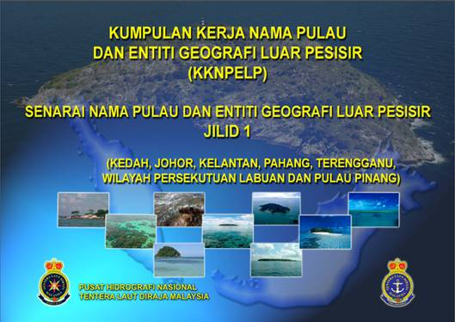
5. Naming of Islands and Geographical Entities
Established in June 2006 and is chair by the National Hydrographic Centre (NHC).
Tasks;
Carry out surveys and researches as well as identifying and proposing the naming of islands and off-shore geographic entities which has no names.
Identify and collect all related information of islands and geographic entities including from charts, gazettes, maps, agreements and related documents.

Slide 20
5. Naming of Islands and Geographical Entities
Documenting and updating the list of islands and geographical entities.
Propose new names for existing islands and geographic entities related to the characteristic of geographical entities in accordance with the guidelines for the Standardization of Undersea Feature Names produced by the International Hydrographic Organization (IHO).

Slide 21
Status in preparing the listing of islands and geographical entities for each state is as follows;
Status | Document | State
Published | Volume I (3rd Edition) | Kedah, Johor, Kelantan, Pahang, Terengganu, Labuan and Penang
 | Volume II (3rd Edition) | Selangor, Perak, Melaka, Perlis, Negeri Sembilan
 | Volume III (1st Edition) | Sabah
Waiting for State Authorities actions | Volume IV | Sarawak

Slide 22
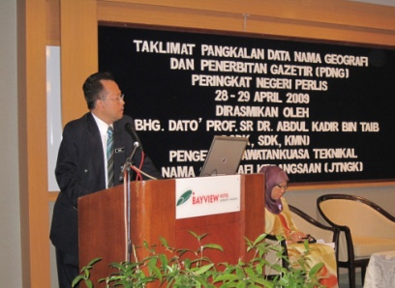
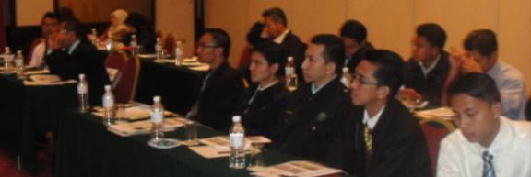
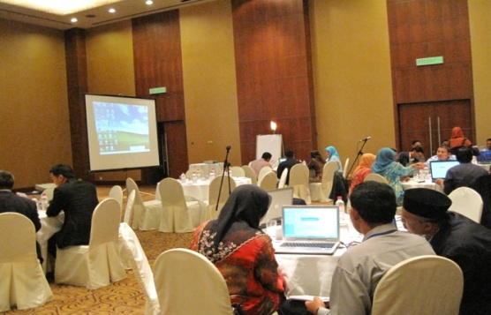
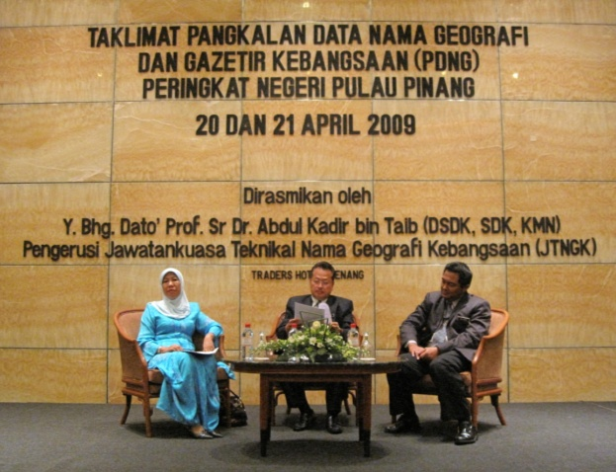
6. Workshop and Briefing
The objective is to disseminate information on the
Guidelines and to discuss the progress of validating the Geographical Names Database.
To help participants understand the importance of
coordinated geographical naming and their input on the Geographical Names Database.
This effort was expected to support the implementation of the MyGDI initiatives which is undertaken by MaCGDI.

Slide 23
7. Toponymic Guidelines for Map and Other Editors
for International Use
This document which will be in both English and Malay language will include several topics as follows:
i. Introduction
Language
Spelling and Pronunciation
iv. Dialect
v. Geographical Names Authority and Standardization of
Geographical Names
vi. Administration Level
vii. Resources
viii. Glossary of Appellatives, Adjectives and Other Words
Necessary for the Understanding of Maps
Abbreviations of Geographical Terms and Other Words Used in Map
Acknowledgements
Reference
Annex (Map of Peninsular Malaysia, Sabah & Sarawak)

Slide 24
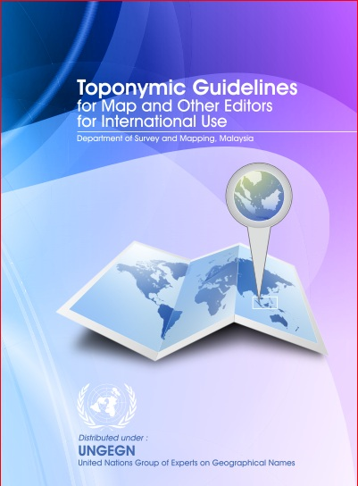
7. Toponymic Guidelines for Map and Other Editors
for International Use
The draft of the document was send to Dr. Hubert Bergmann from Austria, who is the coordinator for UNGEGN Toponymic Gudelines for Map and Other Editors on January 2014 for his comment.
Malaysia is still checking and finalising this guidelines taking into considerations a number of comments and suggestions by Dr. Hubert.

Slide 25
CONCLUSION
Consistent use of accurate place names is an important element in effective communication worldwide, apart from supporting socio-economic development, conservation and national infrastructure.
Standard geographical names can also identify and reflect culture, heritage and landscape.

Slide 26
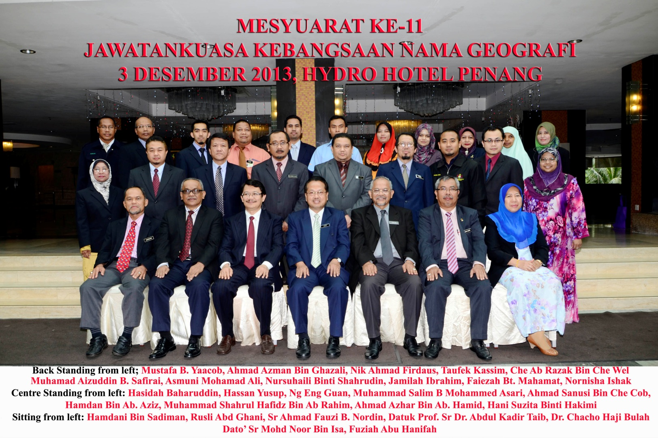
THANK YOU

